Slide 1
W900 Controller – Training Module Dual Pyxis Sensor – Disturbance Applications

Slide 2
Dual Pyxis Sensor – Disturbance Applications
This presentation will cover the following:
> PTSA and Fluorescent Polymer Dual Inline Sensor Features
> Use the Dual Sensor in W900 Disturbance algorithms
On/Off Disturbance Mode
Notes:
W600 Quick Programming Guide: Communications

Slide 3
Dual Pyxis Sensor – Disturbance Applications
PTSA and Fluorescent Polymer Dual Inline ST-588 Sensor Features
ST-588 inline sensor is designed for the direct measurement of both PTSA and “Fluorescent Polymer”
ST-588 sensor has proprietary algorithms to determine the concentrations of PTSA and active polymer residual simultaneously
ST-588 offers a combination of dual (2x) 4-20mA output signals, one for PTSA and one for Fluorescent Polymer.
Notes:
W600 Quick Programming Guide: Communications

Slide 4
Dual Pyxis Sensor – Disturbance Applications
Use the Dual Sensor in W900 Disturbance algorithms
We will look at these programming examples:
On/Off Disturbance Mode
How do we program the Dual sensor analog inputs into the W900 controller?
PTSA ppb is an analog input
Polymer ppm is an analog input
Polymer ppm is also a Virtual input, programmed as Disturbance
Notes:
W600 Quick Programming Guide: Communications

Slide 5
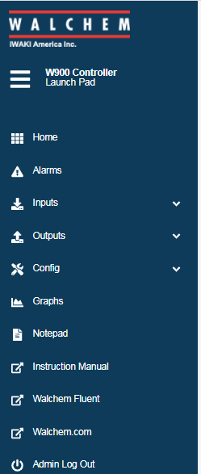
Virtual Inputs
What is a Virtual Input?
Sensor Inputs – Example: Conductivity Sensor
Analog Inputs – Example: Ultrasonic Level Sensor
Digital Inputs – Example: Contacting Head Water Meter
All of the above are physically wired into the controller.
Virtual Inputs – No wires; they can be used to control in
the same manner as the physical inputs
All of the above are found in the controller Inputs Menu

Slide 6
Virtual Inputs
What are the types of Virtual Inputs?
Calculation
Redundant
Raw Value
Disturbance - this is the focus of this training

Slide 7
Disturbance Virtual Input - W900
Disturbance Virtual Input Type
The impact of the secondary input (Polymer ppm) can be more precisely managed by using a new Disturbance type of virtual input channel.
Based on the disturbance input channel selection, process setpoint (PTSA ppb setpoint) and maximum process value, this virtual input generates a value that is used to multiply a primary control value.
Input channel values equal to the setpoint result in an output of 1.0. Therefore, when the disturbance input matches its setpoint, there is no impact on the final control output. In addition, the output value is restricted between low and high limits to allow more complete control over the impact of disturbance inputs.

Slide 8
Disturbance Virtual Input - On/Off Disturbance Mode
Disturbance Virtual Input Type
Disturbance On/Off Control Mode (Discrete)
On/Off control mode is enhanced to add a disturbance input that is multiplied with the user-entered setpoint.
Inhibitor Control from PTSA Fluorometer Adjusted for Polymer Level
Inhibitor feed is commonly controlled based on primary feedback of the product level from a PTSA fluorometer. Trim control on Polymer level (also feedback) is added to adjust the inhibitor feed rate to maintain a desired Polymer level.
The goal is control to 100 ppb of PTSA which should give 10 ppm of polymer in an unstressed system. So if the PTSA is being held at 100 ppb yet the polymer is too low, the PTSA setpoint is increased to feed more polymer into the system.

Slide 9
Disturbance Virtual Input - On/Off Disturbance Mode
Programming Inputs
Polymer (S21) Analog Input: 4mA=0ppm and 20mA=20ppm
PTSA (S22) Analog Input: 4mA=0ppb and 20mA=200ppb
Polymer Disturbance (V1) Virtual Input: See next slide for settings

Slide 10
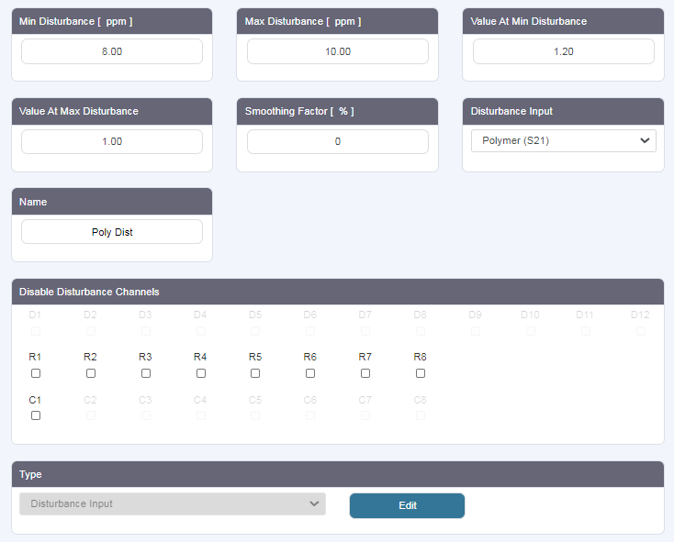
Disturbance Virtual Input - On/Off Disturbance Mode
Polymer
Disturbance
(V1) Virtual Input Menu
Disturbance Input= Polymer (S21)
Type=Disturbance Input

Slide 11
Disturbance Virtual Input - On/Off Disturbance Mode
Polymer
Disturbance
(V1) Virtual Input
These user defined programmed settings are used to calculate the Disturbance Value:
When S21=8ppm (Min Disturbance), the multiplier applied to the PTSA setpoint=1.20
When S21=10ppm (Max Disturbance), the multiplier applied to the PTSA setpoint=1.00
You don’t have to use the whole range of the input. You want to put in the lowest and highest polymer reading and how much you want to multiply the PTSA setpoint by at these extremes.

Slide 12
Disturbance Virtual Input - On/Off Disturbance Mode
Polymer Disturbance (V1) Virtual Input Menu
Calculated Disturbance Input Value
Current Polymer (S21) Input Value
When S21=8ppm (Min Disturbance), the multiplier applied to the PTSA setpoint=1.20
When S21=10ppm (Max Disturbance), the multiplier applied to the PTSA setpoint=1.00
Based on the above user defined settings for Min and Max Disturbance:
At a Polymer Input Value=9.03ppm, the calculated Disturbance Input Value=1.10

Slide 13
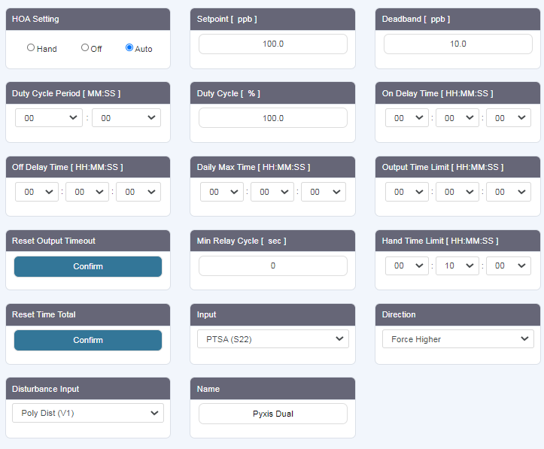
Disturbance Virtual Input - On/Off Disturbance Mode
Output Relay Menu
Programmed as
On/Off Disturbance
The current Setpoint=100ppb of PTSA
Input= PTSA (S21)
Disturbance Input=
Polymer Dist (V1)

Slide 14
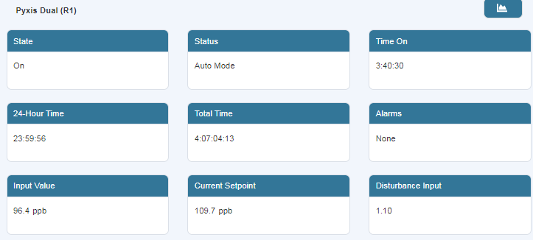
Disturbance Virtual Input - On/Off Disturbance Mode
Output Relay Menu – Programmed as On/Off Disturbance
Disturbance Relay multiplies the original Setpoint times the Disturbance Input to get the Current Setpoint.
So a Polymer Disturbance of 1.10 yields a new PTSA setpoint=109.7ppb
Trim control on Polymer level is added to adjust the inhibitor feed rate to maintain a desired Polymer level.

Slide 15
Open Discussions Questions and Answers
THANK YOU

